Slide 1
BOOTH’S ALGORITHM
BY ANIKET JHA 2K19/EE/040
& ANUBHAV TYAGI 2K19/EE/049

Slide 2
History and Development
Andrew Donald Booth designed the booth’s algorithm.
Booth’s algorithm is a multiplication algorithm.
Multiplies two signed binary numbers in two’s complement notation.
Allows the multiplication of two signed binary numbers in two’s complement form.
This approach uses fewer additions and subtractions than more straight forward algorithm.
Increased system performance.

Slide 3
WHY BOOTH’S ALGORITHM
With advancements in technology, many researchers have already tried and are still trying to design multipliers which provides either greater speed, less power consumption, regularity of layout and hence small area or even combination of them in one multiplier which makes them suitable for various increased speed, minimized power and compact VLSI implementation. The usual multiplication method is ―add and shift parallel algorithm. In parallel multipliers number of partial products that needs to be added is the main parameter that defines the performance of the multiplier. In order to minimize the number of partial products to be added, Booth algorithm and Modified Booth algorithm is one of the most popular algorithms

Slide 4
BOOTH’S MULTIPLICATION ALGORITHM
Booth algorithm gives a procedure for multiplying binary integers in signed 2’s complement representation in efficient way, i.e., less number of additions/subtractions required. It operates on the fact that strings of 0’s in the multiplier require no addition but just shifting and a string of 1’s in the multiplier from bit weight 2^k to weight 2^m can be treated as 2^(k+1 ) to 2^m.
As in all multiplication schemes, booth algorithm requires examination of the multiplier bits and shifting of the partial product. Prior to the shifting, the multiplicand may be added to the partial product, subtracted from the partial product, or left unchanged according to following rules:
Put multiplicand in BR and multiplier in QR
and then the algorithm works as per the following conditions :
1. If Qn and Qn+1 are same i.e. 00 or 11 perform arithmetic shift by 1 bit.
2. If Qn Qn+1 = 10 do A= A + BR and perform arithmetic shift by 1 bit.
3. If Qn Qn+1 = 01 do A= A – BR and perform arithmetic shift by 1 bit.

Slide 5
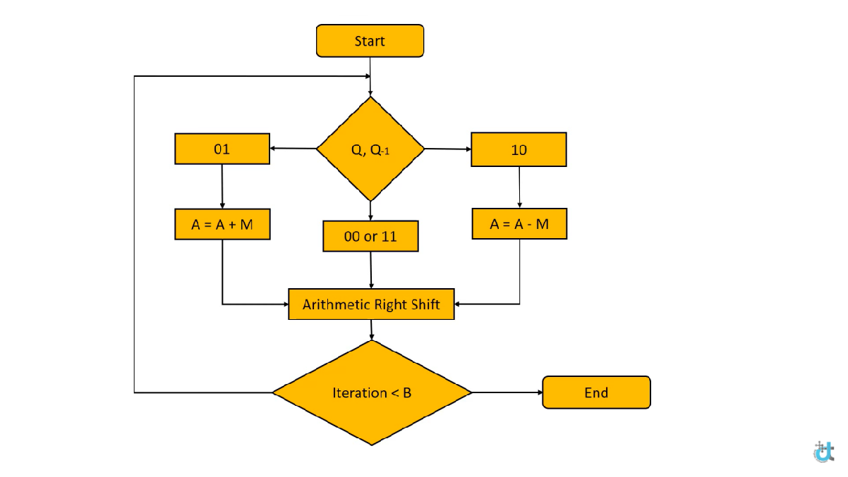
FLOWCHART

Slide 6
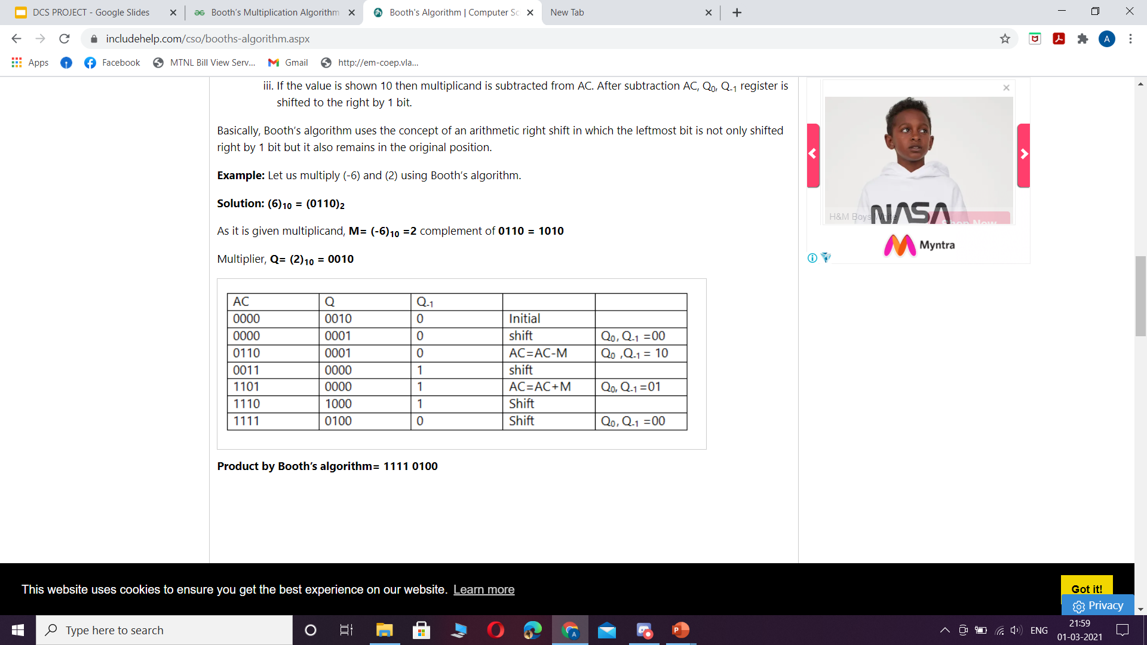
EXAMPLE OF BOOTH’S ALGORITHMS IMPLEMENTATION

Slide 7
WORKING OF CODE (PYTHON):
booths(): It is the main function which is responsible for calling other functions. It also prints the accumulator and multiplier at each step. Its parameters are numbers in string form and it returns the final product string in binary form. It mainly calls perform_operation() function.
perform_operation(): It checks the last two bits of multiplier at each step and performs one of three operations(mentioned above) accordingly and it returns the product in string binary form and the operation which was performed also in string form. It takes three string parameters which are the accumulator, the multiplicand and the last two bits of the multiplier. It calls functions shift(), subtract() and Add()

Slide 8
subtraction(): It is a simple function which subtracts two values in binary form. Its parameters are two string numbers and it returns the result in binary string form.
Add(): It simply adds two values in binary form and returns the binary string form. It takes parameters which are two string numbers.
shift(): This function simply shifts the binary string by one position to the right. Its return value and parameter are both strings in binary form
positiveBinaryConversion(): It converts a positive integer into binary form. It takes a non negative integer as parameter and returns a string in binary form.
twoscompliment(): It converts a negative number into its two's complement form. It takes the negative integer as parameter and returns its two's complement string in binary form.
binToDec(): It converts a binary string into its decimal value and returns the decimal value as string. It takes a string as a parameter which is in binary form

Slide 9
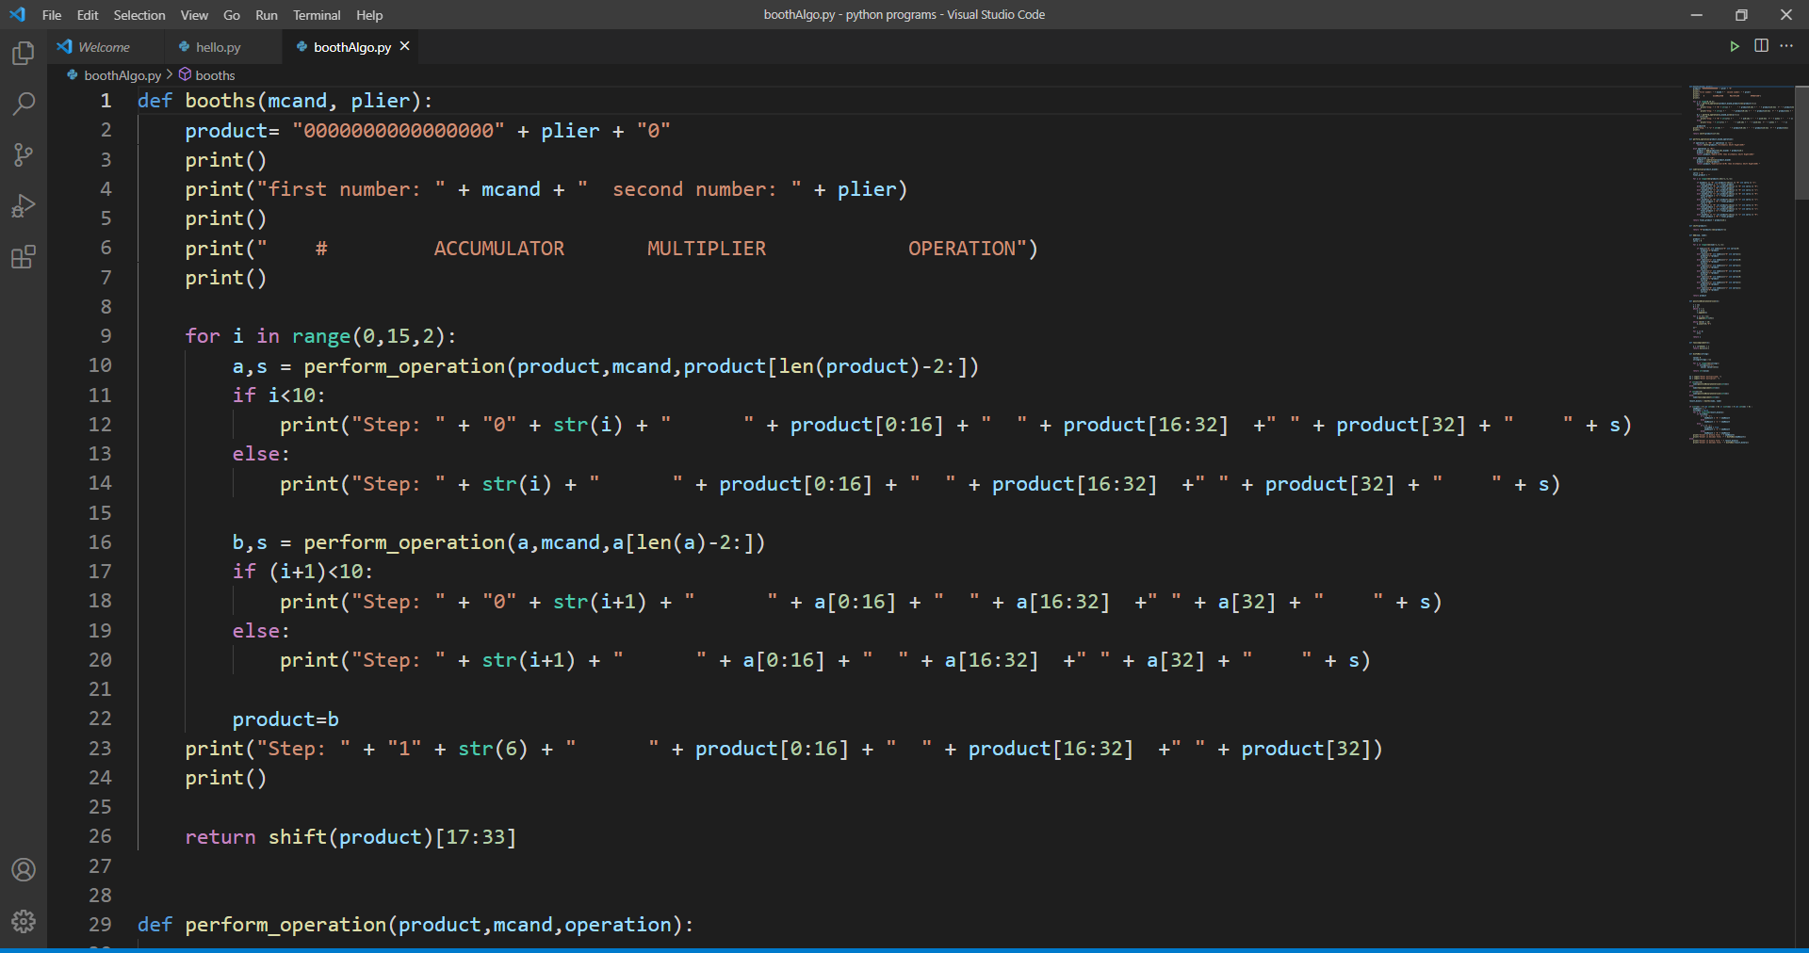

Slide 10
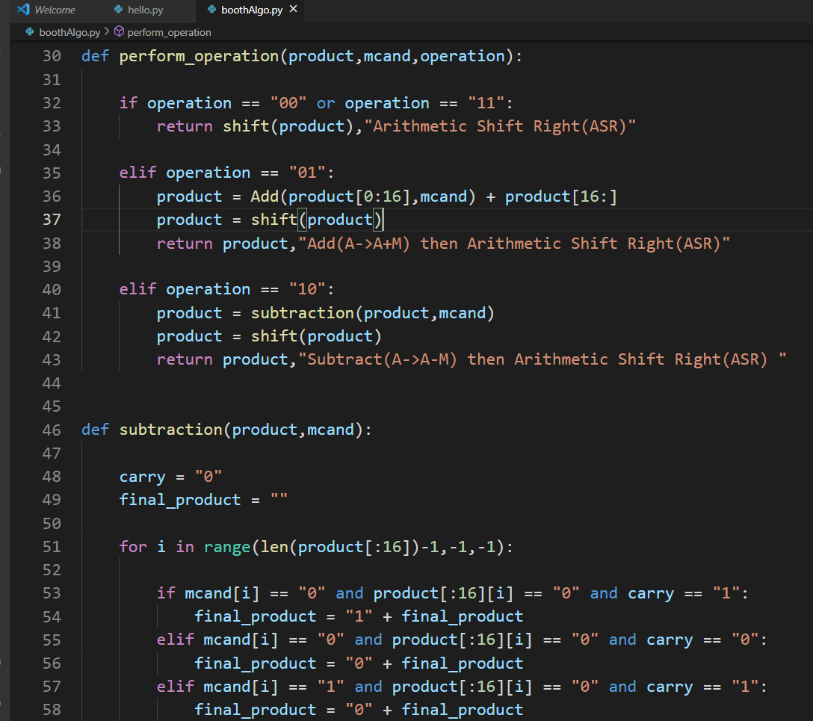
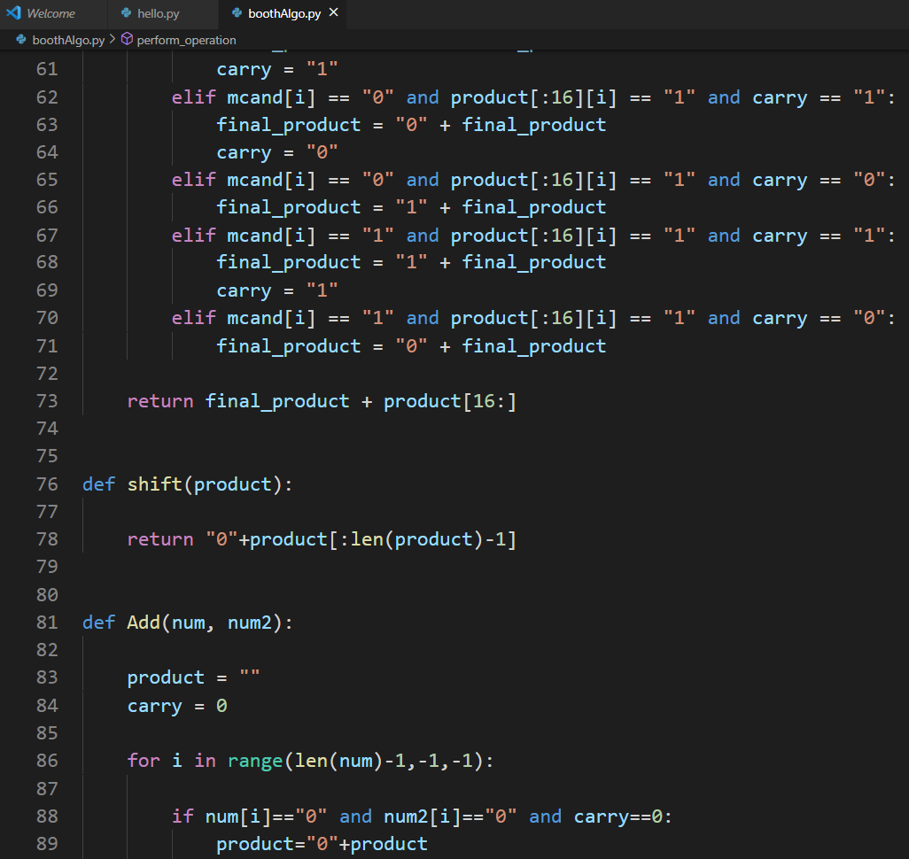

Slide 11
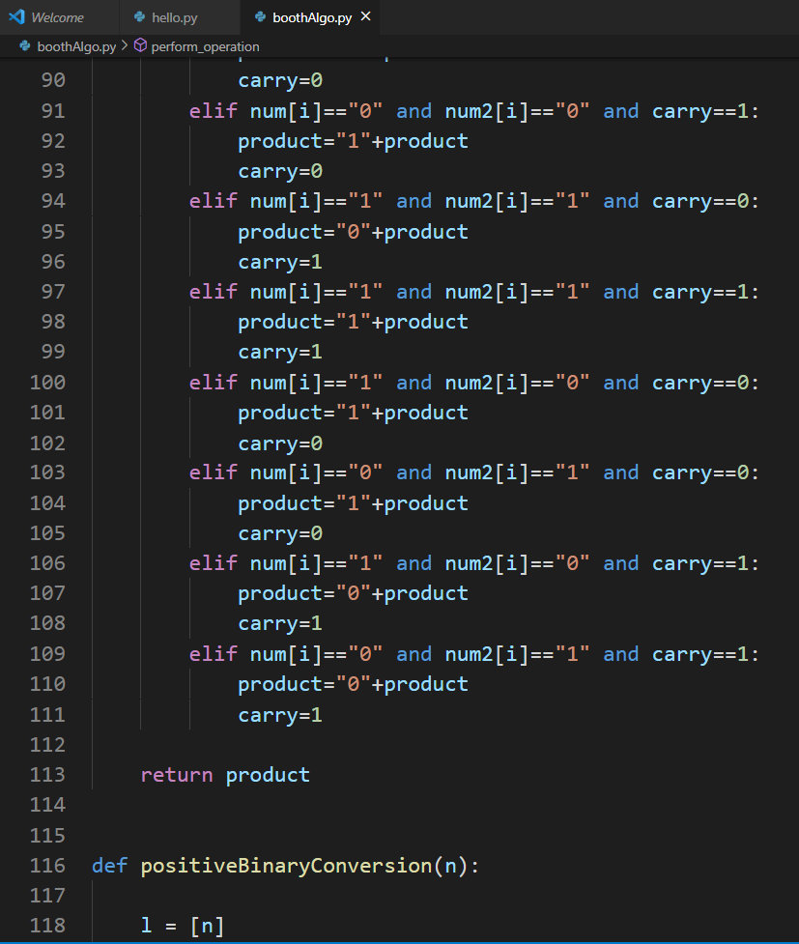
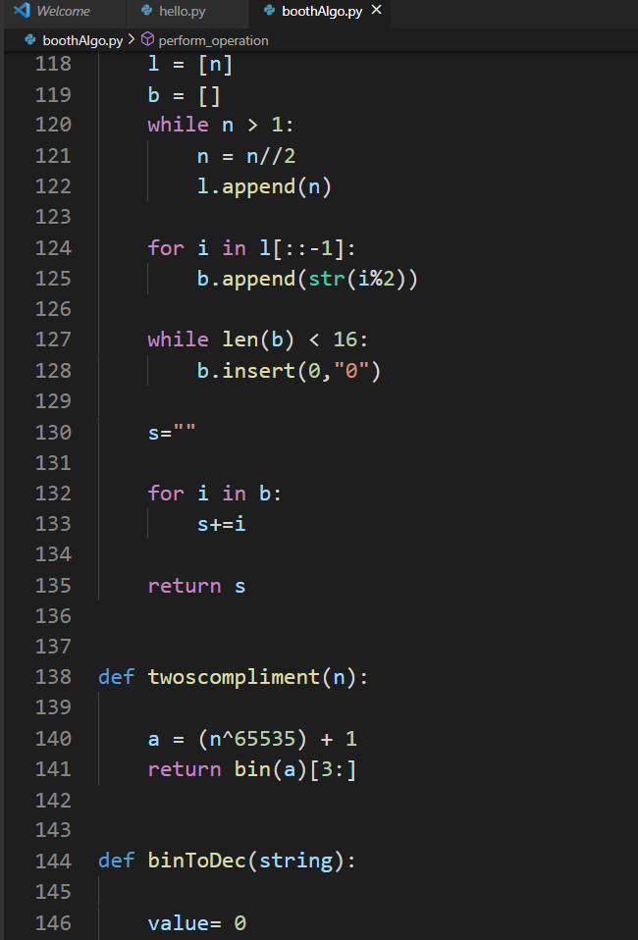

Slide 12
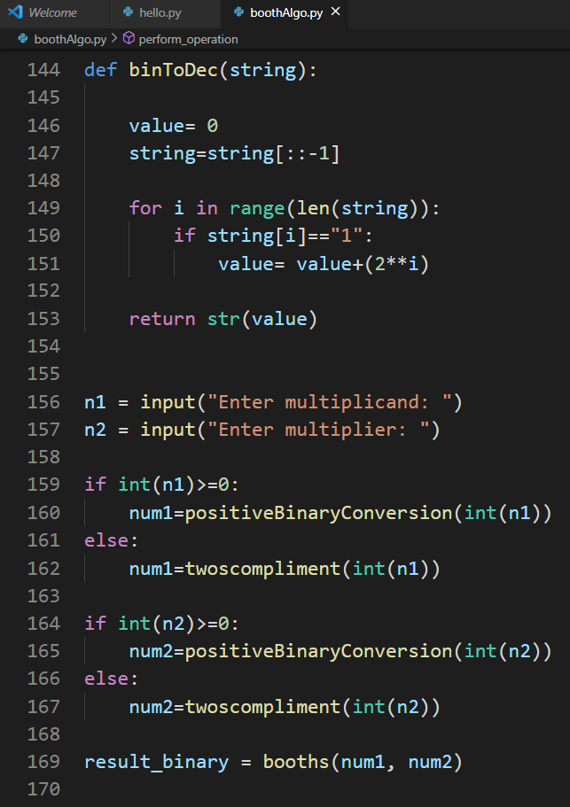
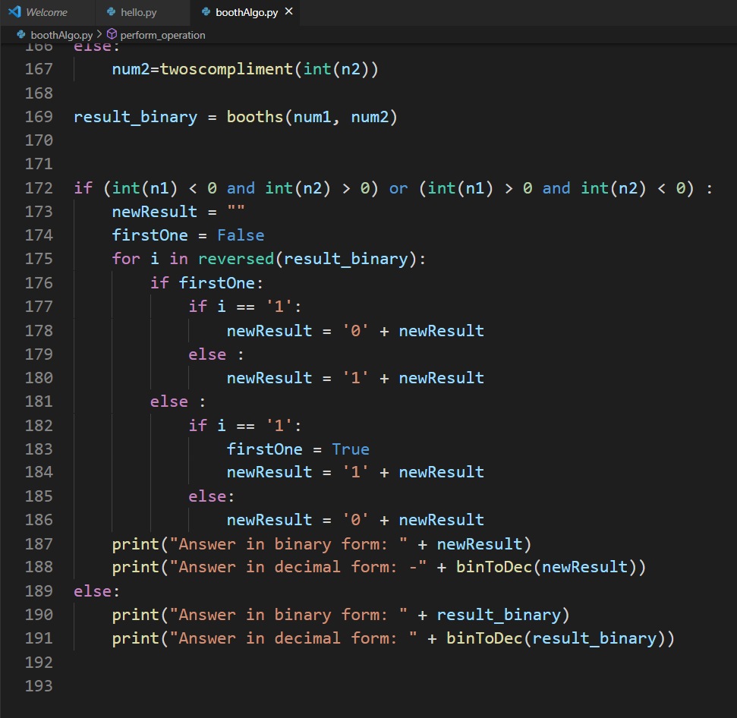

Slide 13
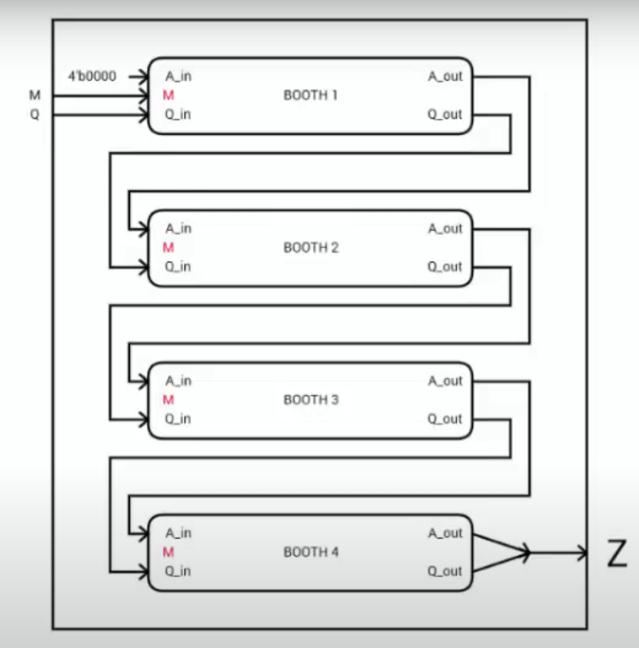
CODE ARCHITECTURE

Slide 14
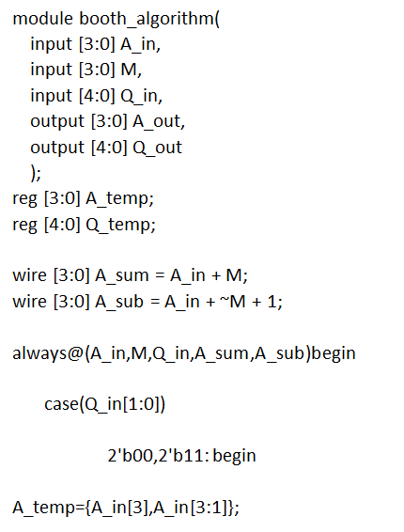
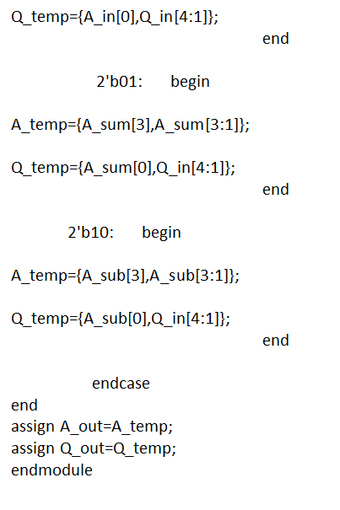
BOOTH’S ALGORITHM MODULE

Slide 15
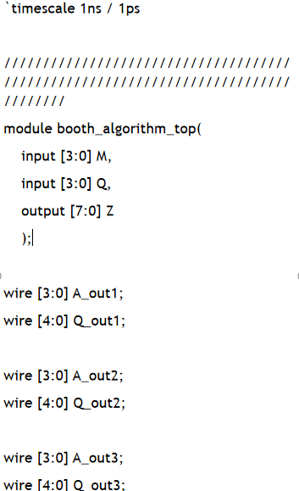
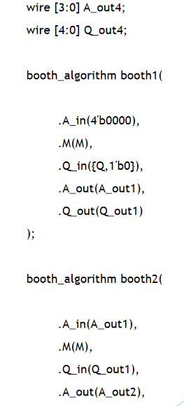
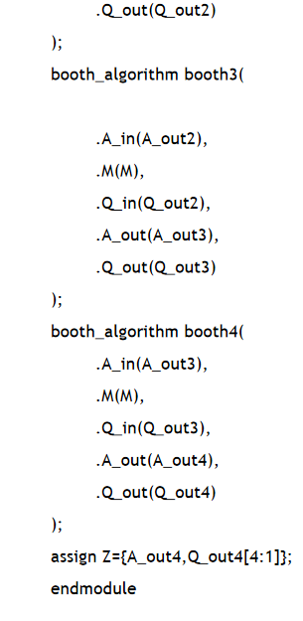
MODULE INSTANTIATION

Slide 16
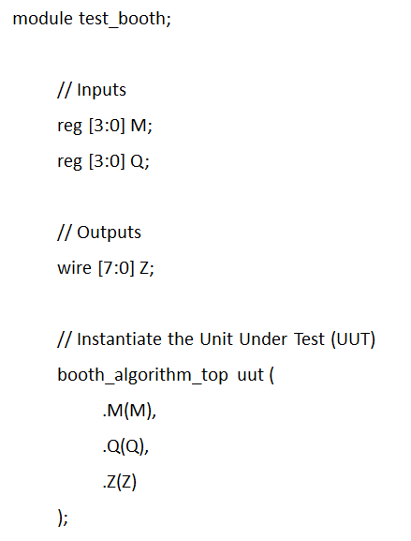
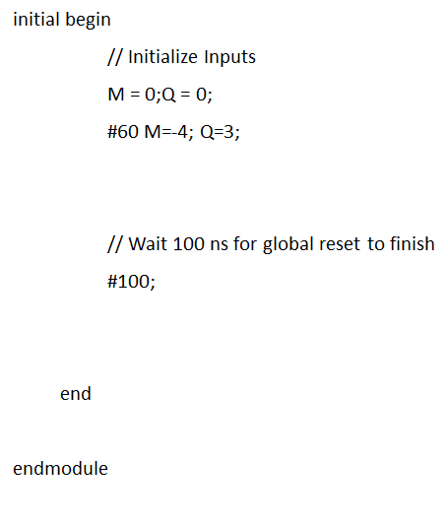
TEST BENCH

Slide 17
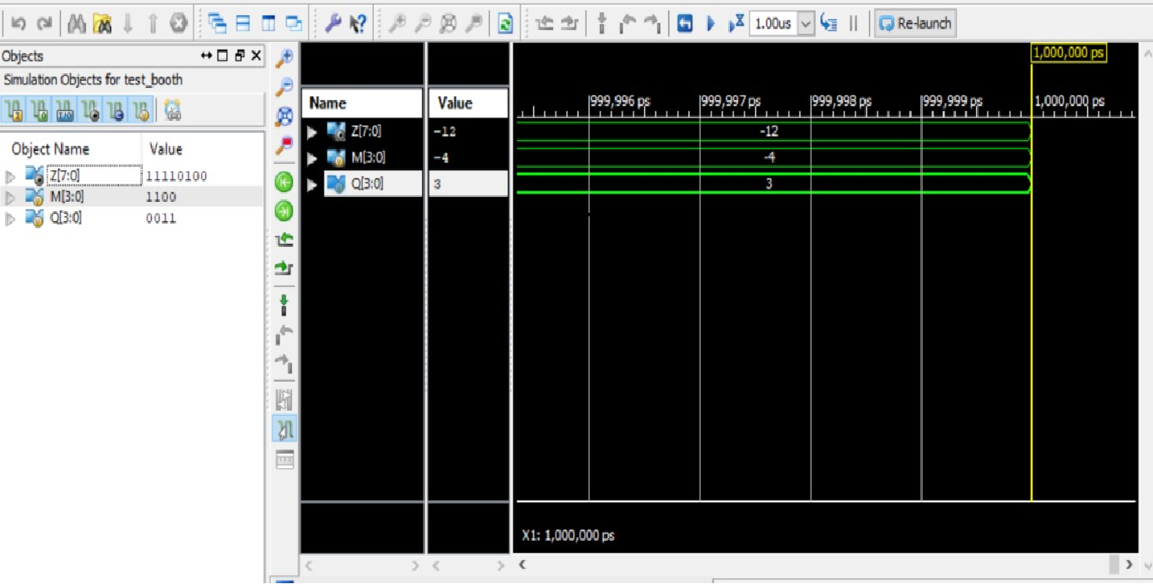

Slide 18
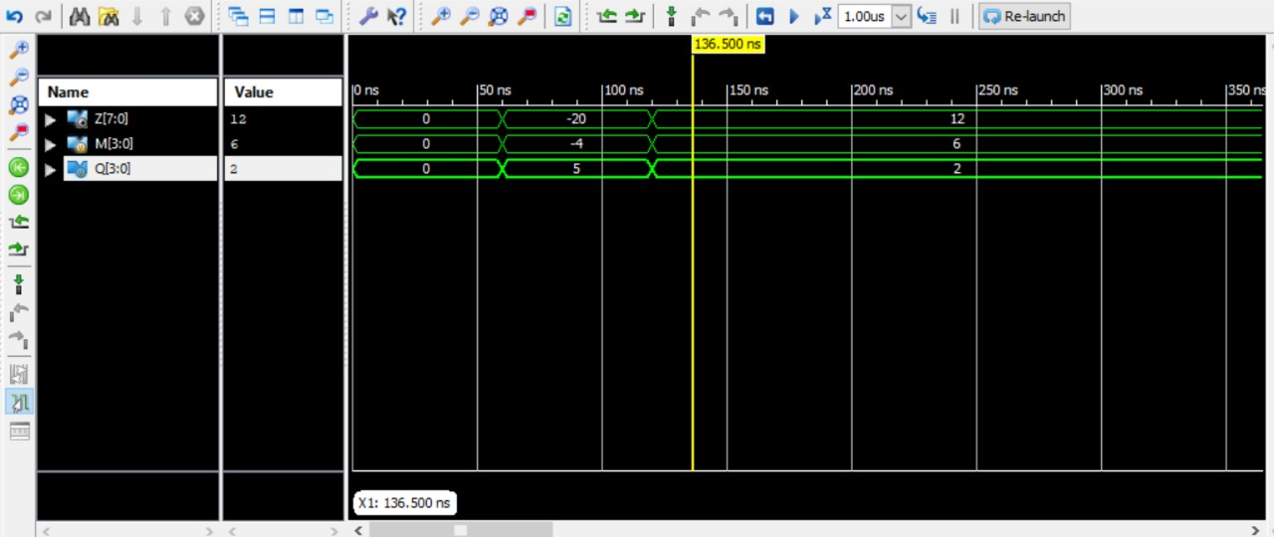

Slide 19
APPLICATIONS OF BOOTH ALGORITHM
Digital multipliers are also utilized in digital signal processors, such as radar and sonar.
In many applications, processing of analog signals in digital form in real time would not be practical without high speed digital multipliers.
Other applications include fast Fourier transform processors and high speed floating point arithmetic logic units.

Slide 20
THANK YOU

